Slide 1
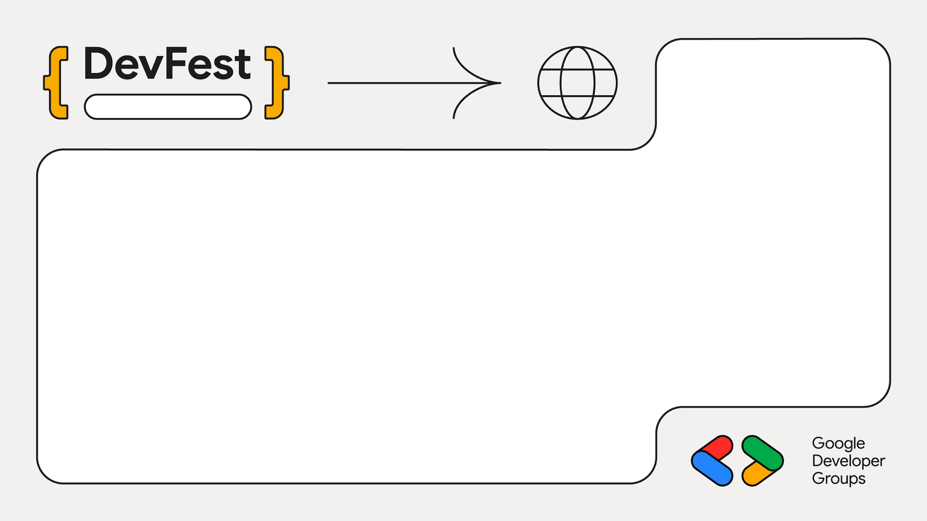
2025
Mumbai
Small Model, Big Impact:
Gemma + PEFT + Android Inference
Mayur Madnani

Slide 2
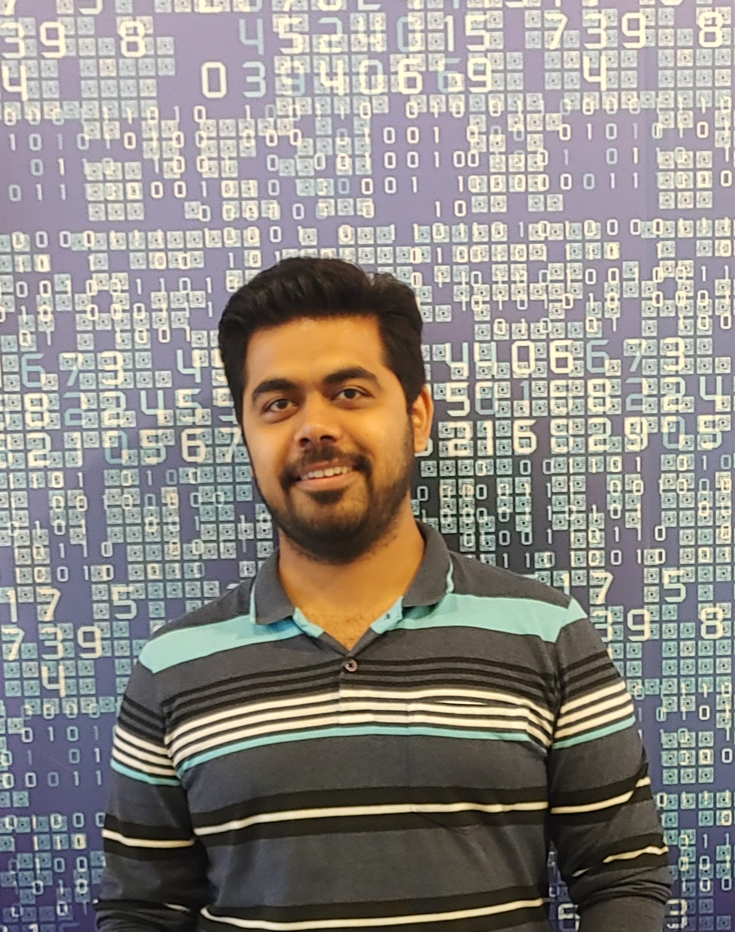
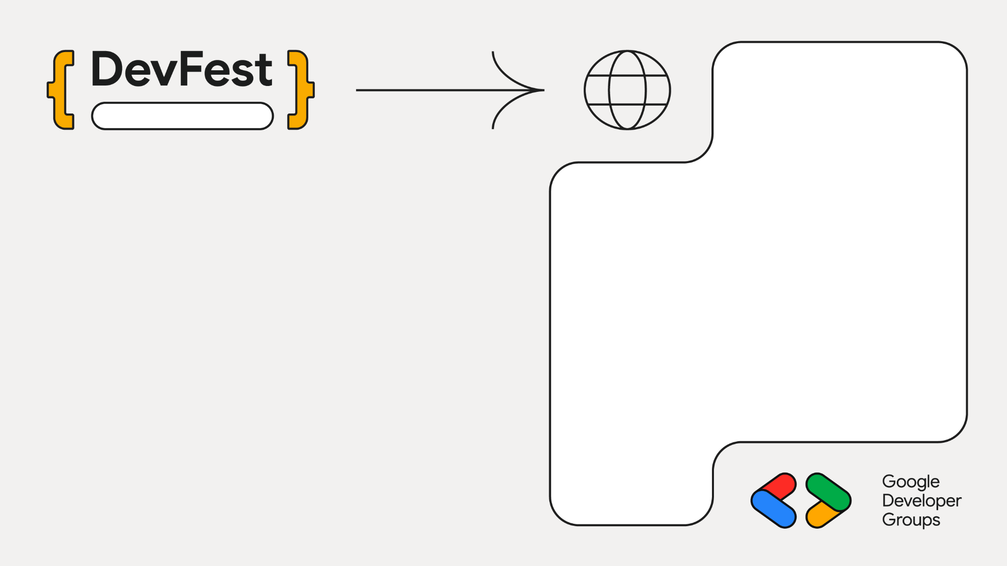
Mumbai
Staff Engg @ JioHotstar
Previously @ Intuit, Walmart, SAP
Expertise in Data, AI and Backend
~10 years in the Industry
GenAI Course Author
Mayur Madnani

Slide 3
1
The Context

Slide 4
LLMs / SLMs
Large Language Models (LLMs)
Small Language Models (SLMs)
Massive Scale
Knowledge Transfer
Deep Architecture
Compact Architecture
Versatile
Precision focused
Resource Intensive
Agentic & privacy focus
Performance
Domain specialist

Slide 5
LLMs / SLMs
Feature | LLM | SLM
Philosophy | One model to rule them all | Right tool for the right job
Scale | Massive parameters (100B+) | Compact & Efficient (<10B)
Focus | General purpose versatility | Domain precision & Agentic workflows
Resources | Requires data center clusters | Runs on consumer GPUs/edge devices
Outcome | Raw Knowledge Capability | Privacy, Speed, and ROI

Slide 6
Introducing Google Gemma
Decoder Only
Gemma
Advanced Attention
Gemma 2
Smart Embeddings
Gemma 3
The MatFormer
Gemma 3n

Slide 7
1
The Context
2
The Challenge

Slide 8
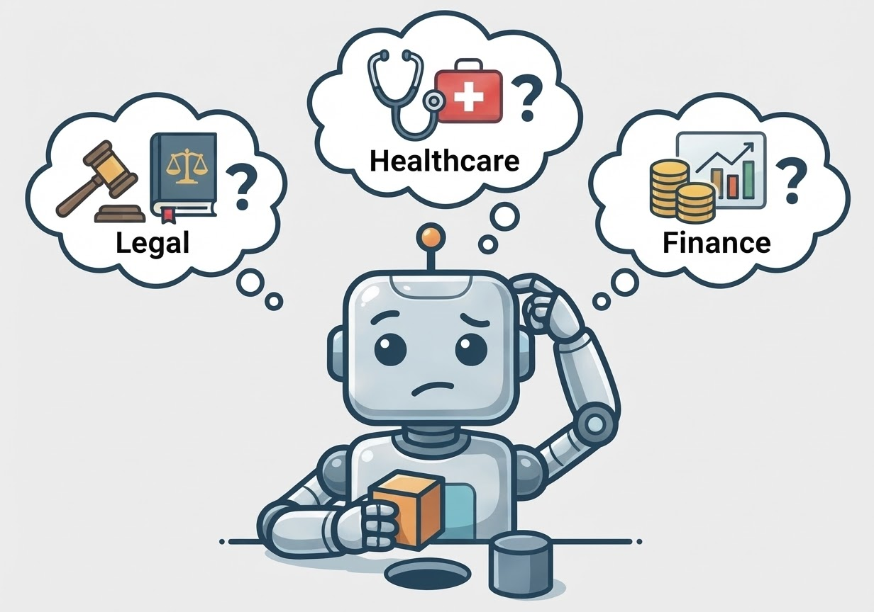
The “Generalist” Problem

Slide 9
The “Generalist” Problem
Domain Mismatch
Struggle in specialized fields
Static Knowledge
Real time information & context
Deployment Constraints
Cost and Practicality

Slide 10
1
The Context
2
The Challenge
3
The Fix

Slide 11
Model Adaptation
Technique | Use Cases | Cost
Prompt Engineering | Guided reasoning without training
Parametric (Full) | Complete retraining
Semi-Parametric | Injecting live facts/documents
Parametric (Efficient) | Updating specific skills

Slide 12
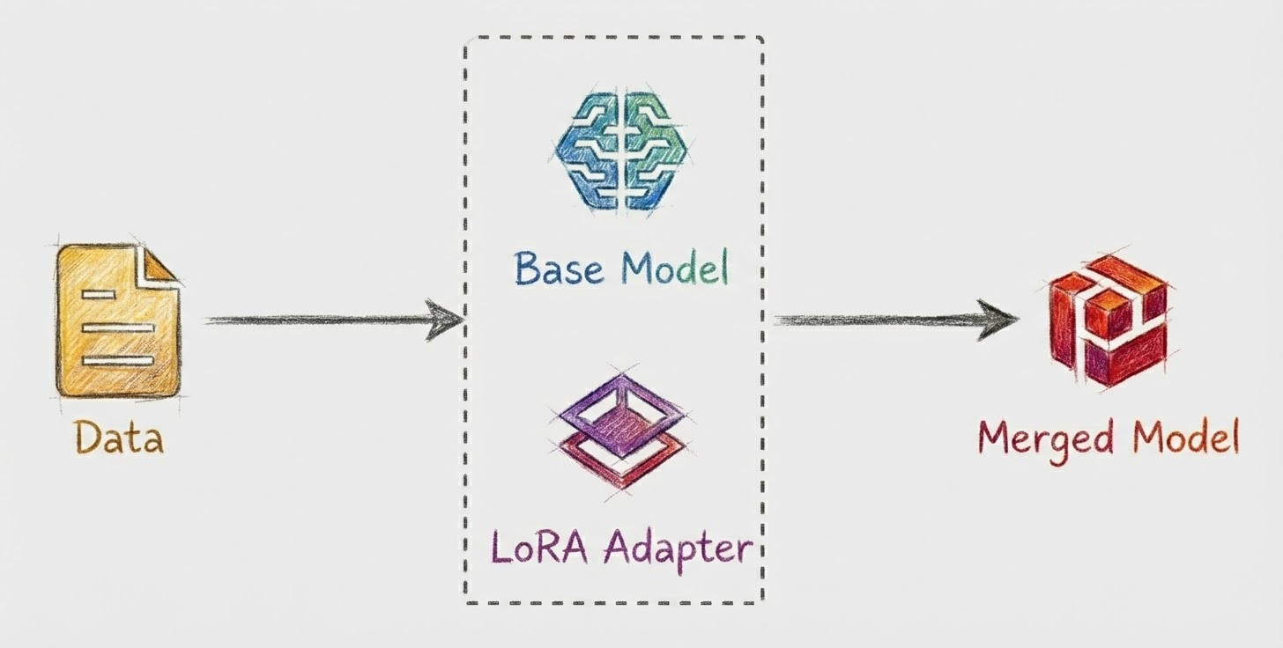
Low-Rank Adaptation (LoRA)

Slide 13
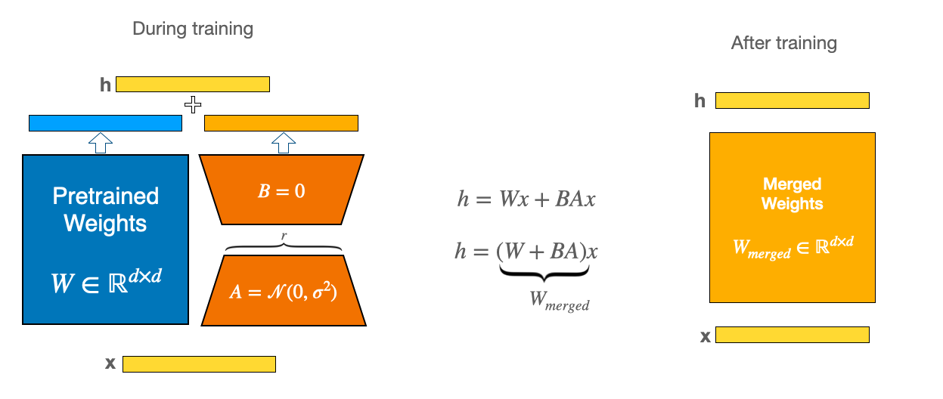
Low-Rank Adaptation (LoRA)

Slide 14
1
The Context
2
The Challenge
3
The Fix
4
The Proof

Slide 15
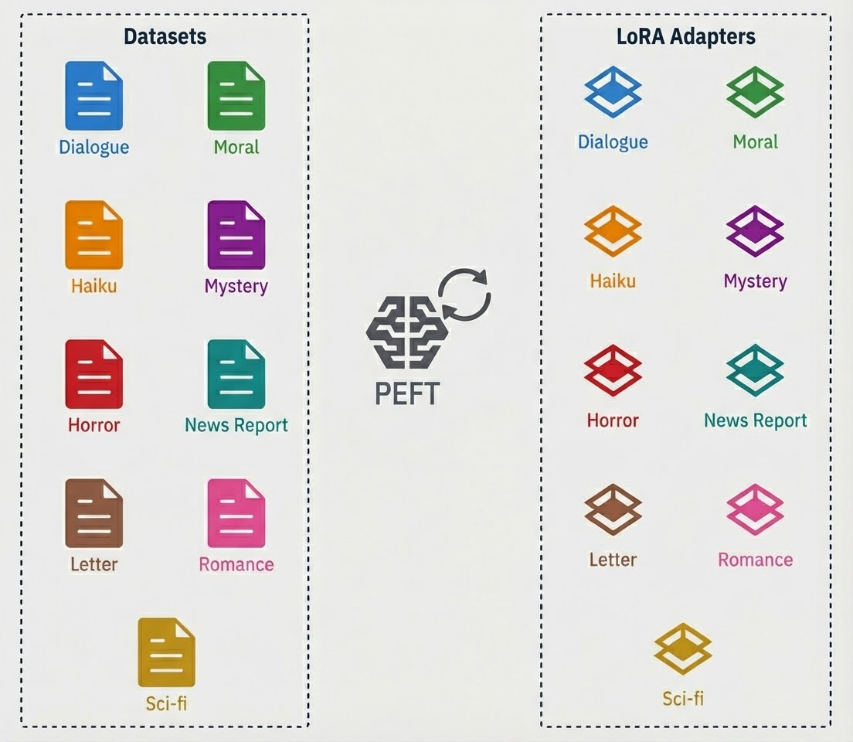
LoRA Adapters

Slide 16
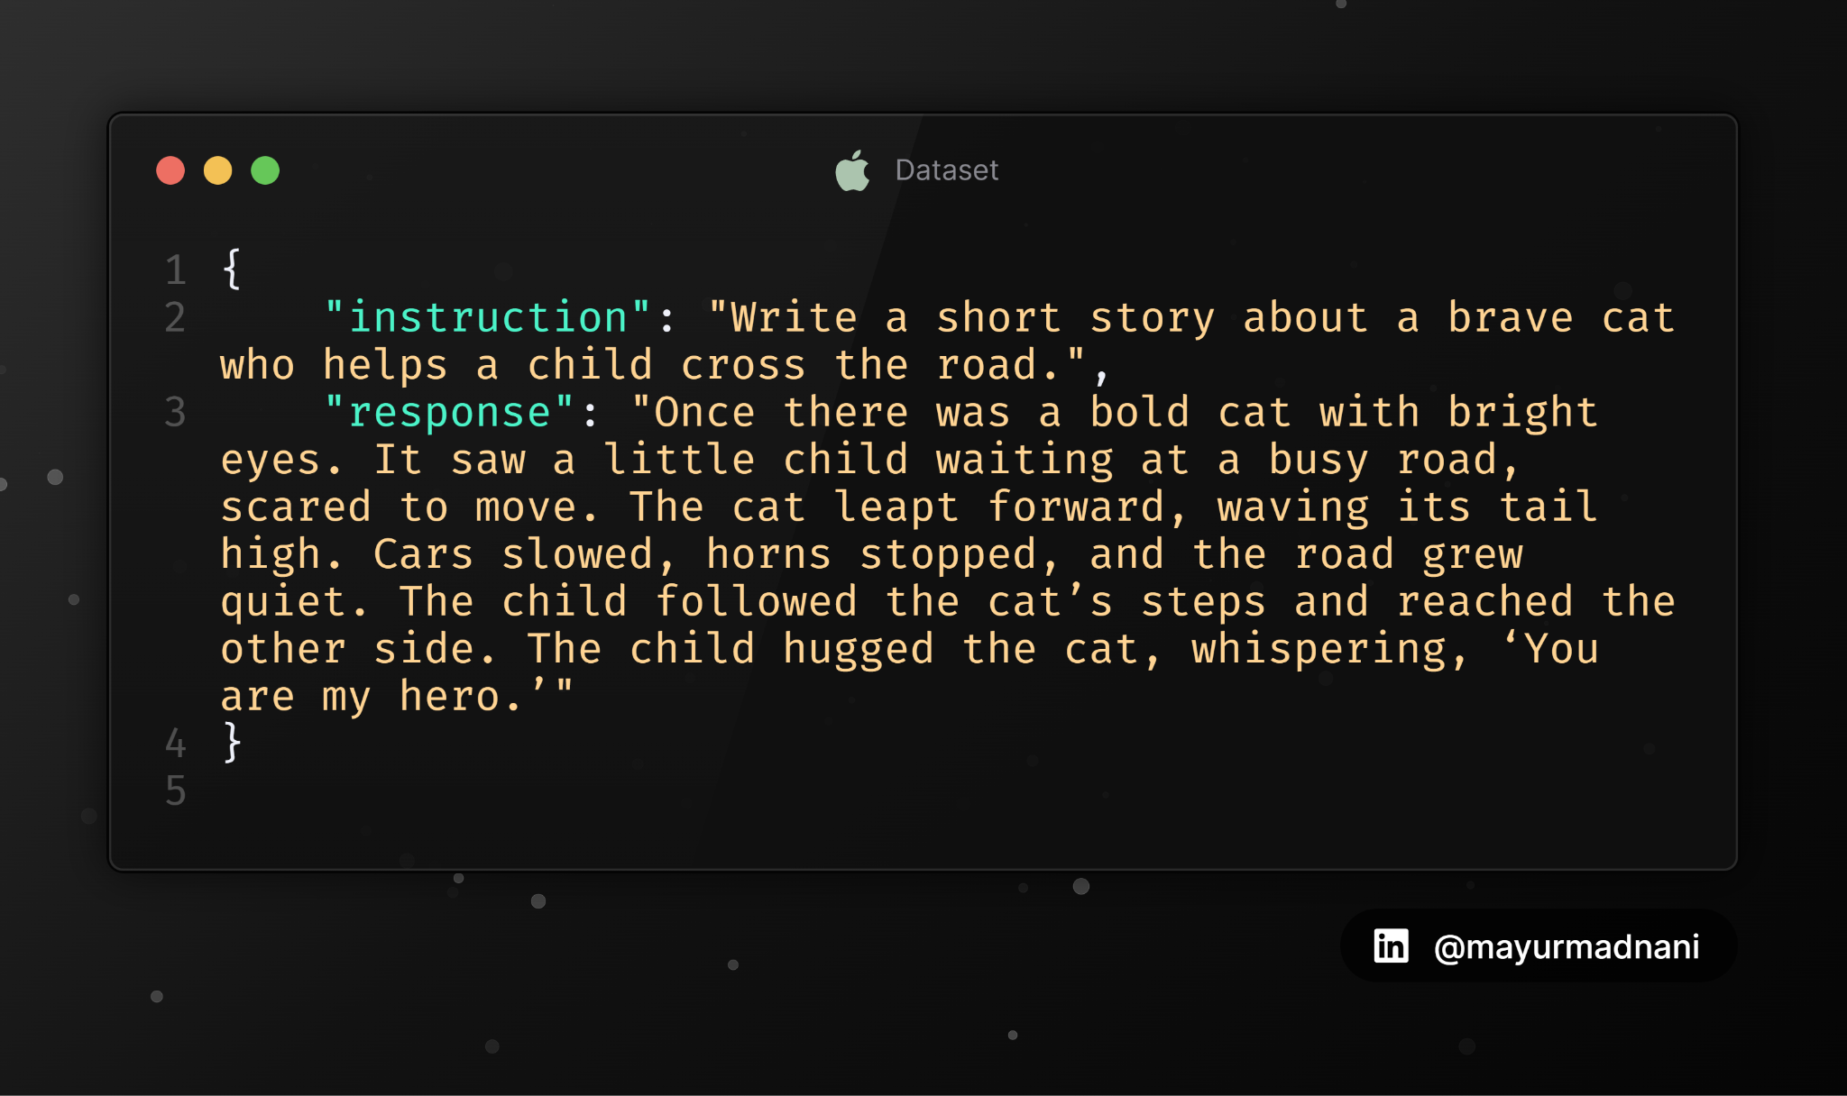
Dataset

Slide 17
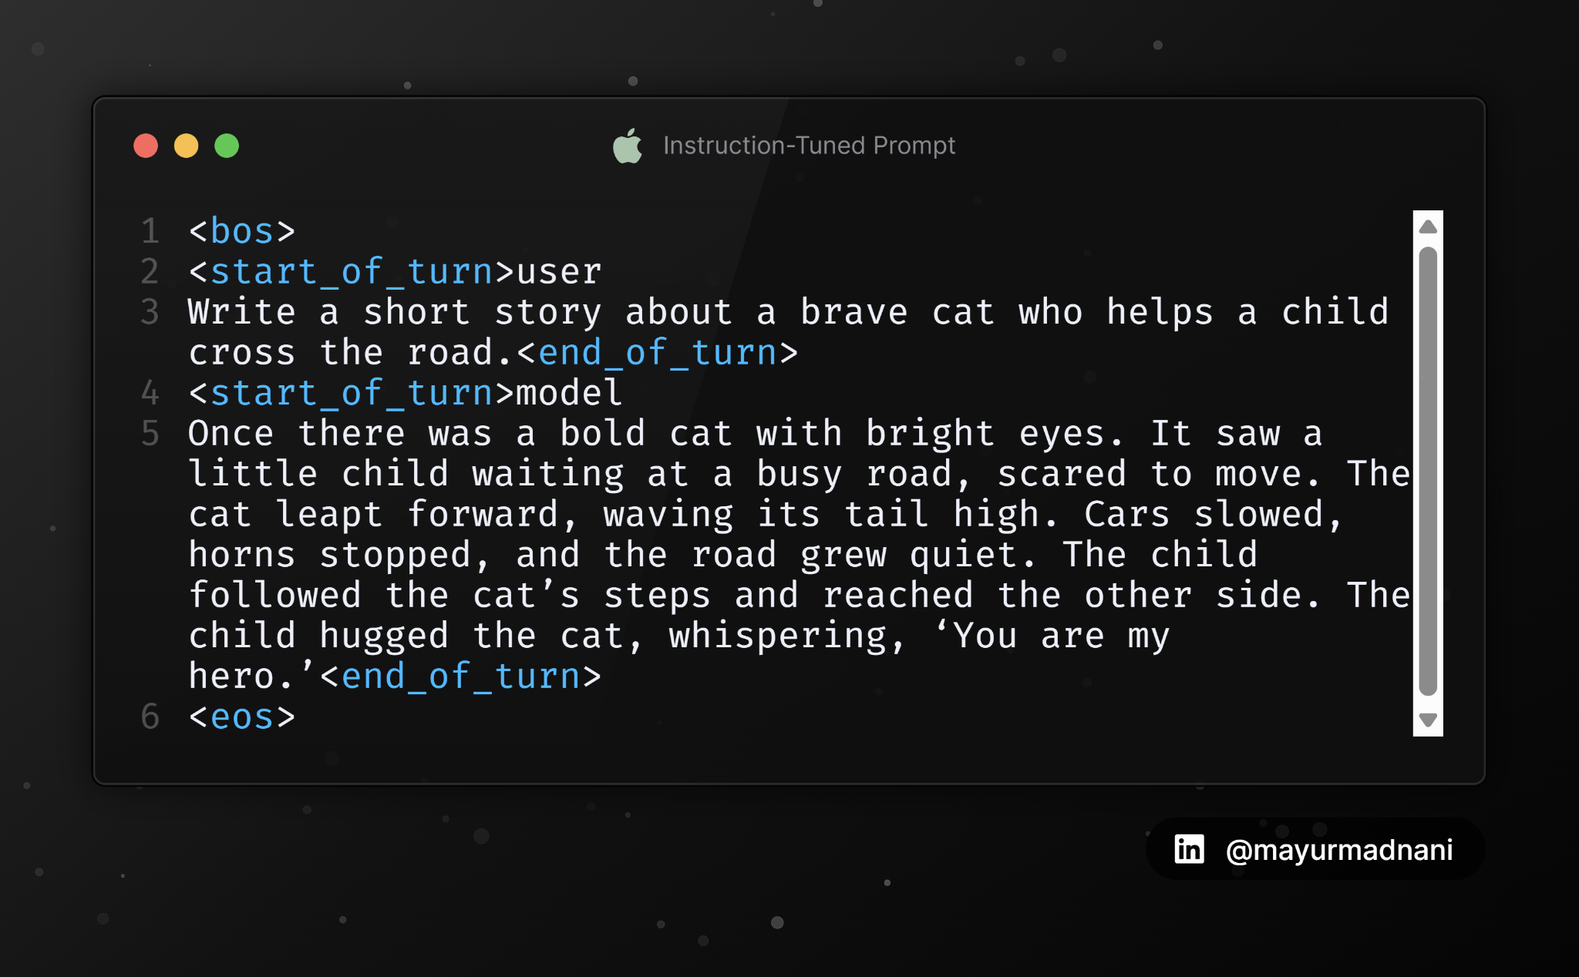
Instruction Tuning

Slide 18
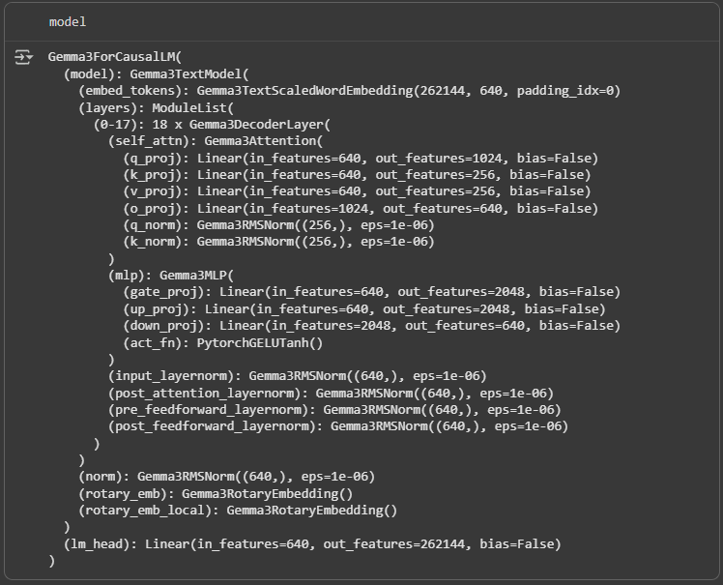
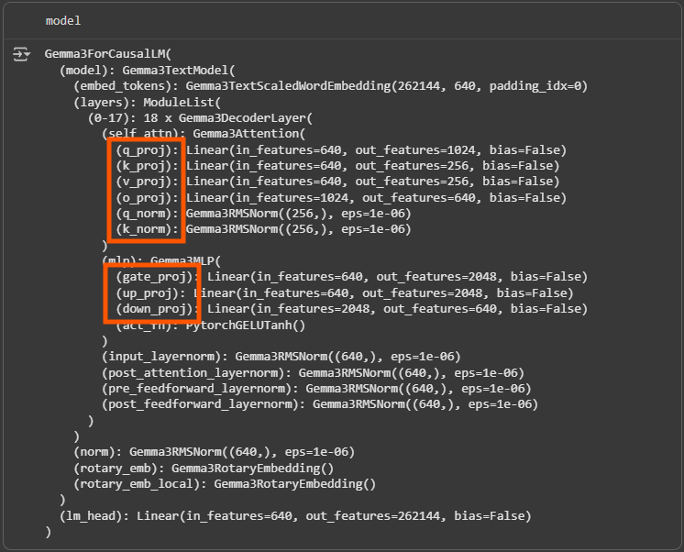
Base Model

Slide 19
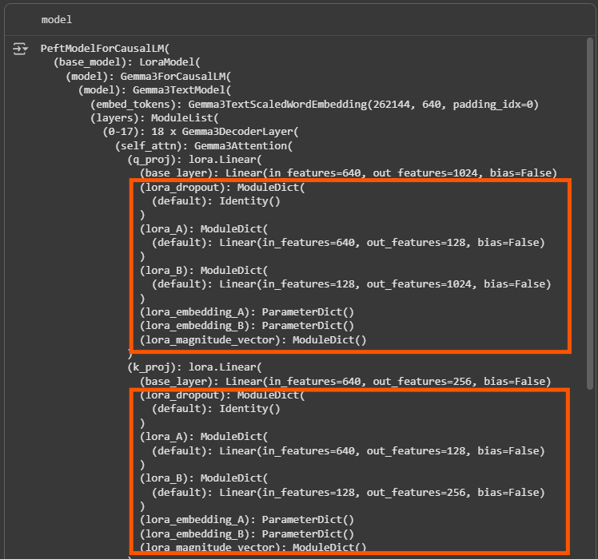
LoRA / PEFT Model

Slide 20
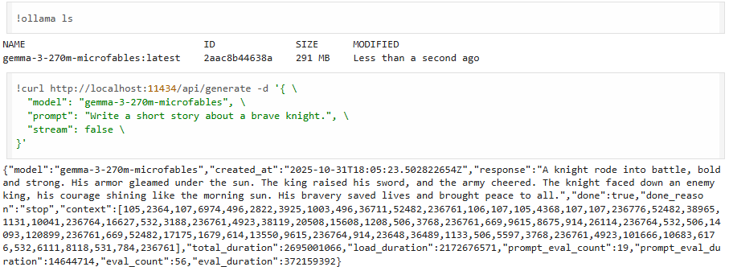
Try them out!

Slide 21
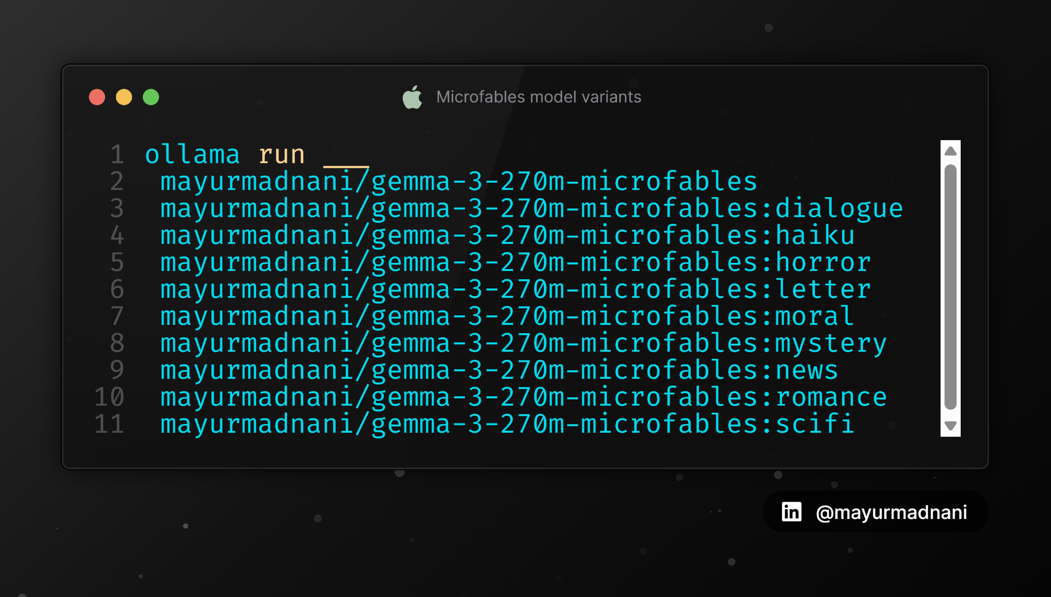
Try them out!

Slide 22
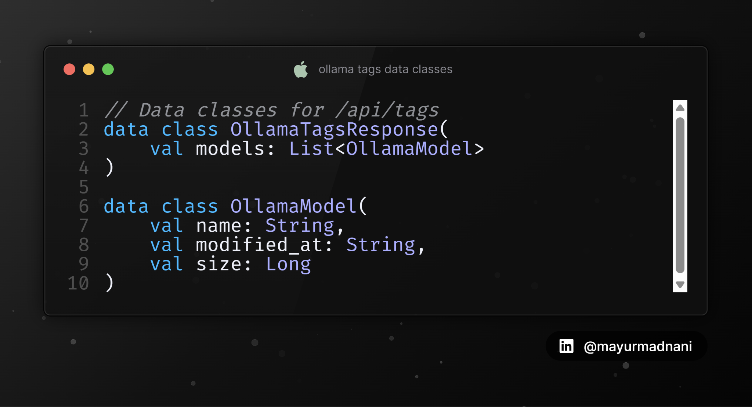
Ollama API- Tags

Slide 23
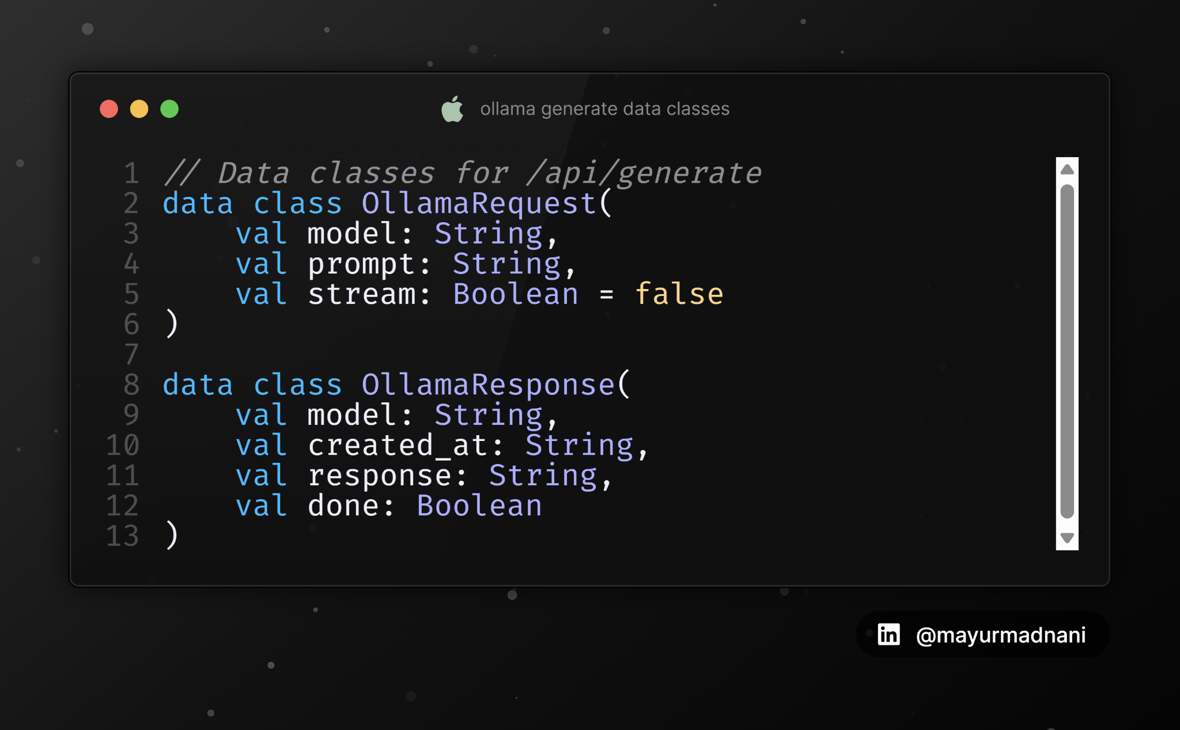
Ollama API- Generate

Slide 24
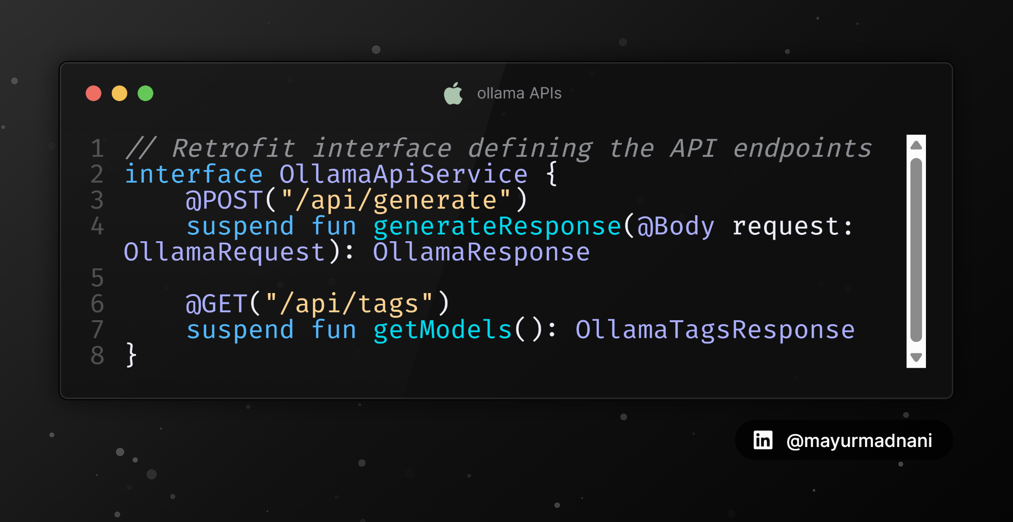
Ollama API- Interfaces

Slide 25
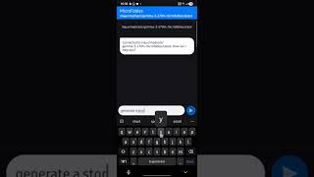
Demo

Slide 26




Key Takeaways
1
Shift from Giants to Specialists
2
Scaling down for practical utility
3
Adaptation- Jack of all trades into a Master of One
4
The Modular Ecosystem

Slide 27

Github
https://github.com/mayurmadnani/MicroFables

Slide 28

LinkedIn
https://linkedin.com/in/mayurmadnani

